Slide 1
Repetition Structure I
while loop and flow control

Slide 2

Objectives
At the end of this lecture, you will be able to….
apply the use of repetition structure in the creation of programs
code using while loop
alter the program flow of loops with break and continue statements
Notes:
In this lecture we will be learning about how to use repetition structure in programs. Coding using while loop and alter the flow of the loop with break and continue statements.

Slide 3
Topics
What is Repetition Structure
while loop
Control Flow Statements
break
continue
Notes:
The list of topics for this lecture is as follows

Slide 4
Repetition Structure

Slide 5
What is a Repetition Structure?
Execute a block of program statements repeatedly
2 types of repetition structure
while loop and for loop
Examples of repetitive activities:
Repeated prompting of password after incorrect entry
Siri listening for wake-up command
Fitness watch measuring heart rate throughout the day
Notes:
A repetition structure is one that execute a block of program statements repeatedly. There are 2 kinds of loop, for loop and while loop.
Some examples of repetitive activities are, repeated prompting of password upon incorrect entry, a computer repeatedly listening for and input like siri, a fitness watch measuring heart rate throughout the day.

Slide 6
while loop

Slide 7
while Loop
Checks the condition
if the condition is true, executes the block of statements in the loop
Repeat from step 1 until condition is false
while condition:
statement
statement
False
condition
True
block of statements
Notes:
A while loop follows this process.
It first checks the given condition of the loop.
If the condition evaluates to true, the block of statements in the loop gets executed.
Then it will return to step 1 until the condition evaluates to a false.

Slide 8
while Loop
Typical condition statement includes
Controlling the number of iterations the loop will execute
Terminating the loop with special sequence of character(s), also known as sentinel
while condition:
statement
statement
False
condition
True
block of statements
Notes:
Typical condition statement includes the number iterations the loop will execute, and terminating the loop with special sequence of character, also know as sentinel.

Slide 9

Example: Control Number of Iterations
Print number 1 to 5
Pseudocode:
Python code:
SET count to 1
WHILE count less than or equal to 5 THEN
display count
increment count
ENDWHILE
count = 1
while count <= 5:
print(count)
count = count + 1
Notes:
An example of a while loop with a controlled number of iteration.

Slide 10
Terminate with Sentinel
A Sentinel value is also referred to as a flag value, trip value, rogue value, signal value, or dummy data
It is a special value used as a condition of termination, typically in a loop.
Notes:
Sentinel value is referred to as a flag value, trip value, rogue value, signal value, or dummy data, a value used in loops as a condition to terminate the loop.

Slide 11
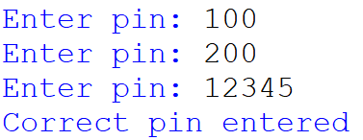
Example: Terminate with Sentinel
Prompt the user for pin number until correct pin has been entered
pin = 0
while pin != '12345':
pin = input('Enter pin: ')
print('Correct pin entered')
Notes:
An example loop that terminates upon an input of the correct pin.

Slide 12
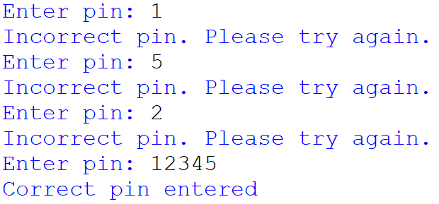
Example: Terminate with Sentinel
Prompt the user for pin number until correct pin has been entered
correctPin = '12345'
correctEntry = False
while not(correctEntry):
pin = input('Enter pin: ')
if(pin == correctPin):
correctEntry = True
else:
print('Incorrect pin. Please try again. ')
print('Correct pin entered')
Notes:
An example of a program that prompts the user that the incorrect pin is entered, please try again.

Slide 13
Activity 1: TemperatureSensor.py
A room is installed with a sensor that measures the room temperature at an hourly interval. The temperatures are stored in a list named tempList. Calculate the average temperature reading for the day.
Pseudocode:
read measurement #1
add to total
….
read measurement #24
add to total
average = total / 24
Repeated

Slide 14
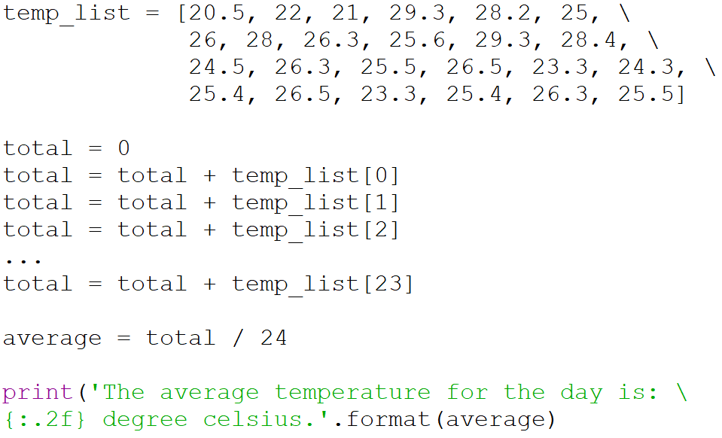
Activity 1 – TemperatureSensor.py
Previous Program:
Repeated code

Slide 15
Activity 1 – TemperatureSensor.py
Modify the program in Activity 1 with the use of the while loop
Notes:
Try using while loop to modify the code highlighted in the previous slide

Slide 16
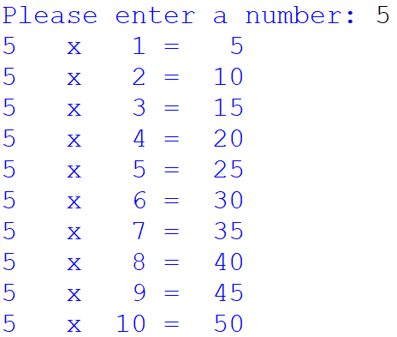
Activity 2: NumberTable.py
Write a program that prompts the user to enter a number, and print out the math timestable with the use of a while loop.

Slide 17
Infinite Loop
A loop that will not terminate is called an infinite loop.
Infinite loop occurs as its condition always evaluates to True
Execution of the program can only be stopped by “killing” the program.
So it is important to make sure the condition of the loop will eventually become false so that the loop will terminate.
Notes:
An infinite loop is a loop that will not terminate.
An Infinite loop occurs as its condition always evaluates to True
The Execution of the program can only be stopped by “killing” the program.
So it is important to make sure the condition of the loop will always end up to be false so that the loop can terminate.

Slide 18
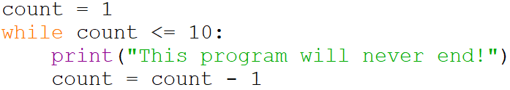
Infinite Loop - Examples
Can you explain what causes infinite loop in each of these cases?
Notes:
These are some examples of infinite loops

Slide 19
Activity 3 – Which are Infinite Loops?
Determine if the following code will result in infinite loop?
while not(True):
print() no
while 0: print() no
count='0'
while count!=0:
print() yes
count=0
while count>=0:
print() yes

Slide 20
Control Flow
Break
continue

Slide 21
break Statement
A break statement can be used to exit from a loop
When a break statement is executed within a loop,
the loop is terminated
program control is passed to the first statement after the loop.
A break statement is often written in an if block when it is used in a loop
Notes:
A break statement will cause the program to exit from the loop.
When a break statement is executed inside a loop, the loop will be terminated. The program control is passed to the first statement after the loop.
Break statements are usually written inside an if block when used in a loop.

Slide 22
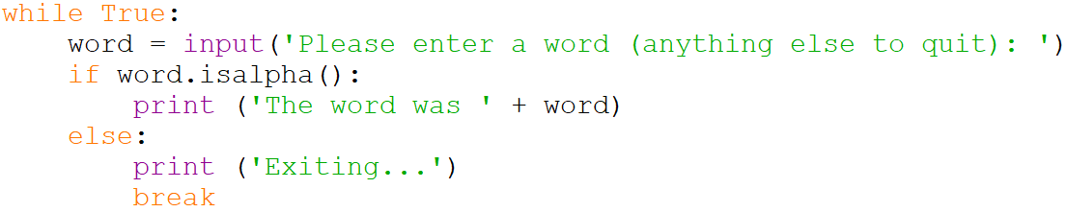
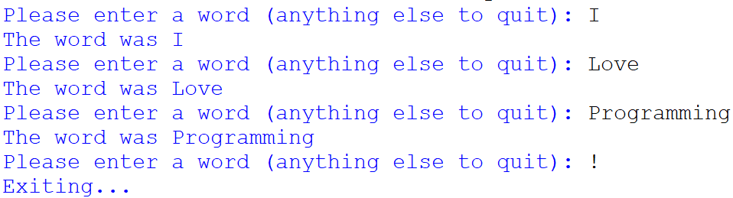
break Statement - Example
Notes:
Example of using a break statement within a loop.

Slide 23
continue Statement
A continue statement can be used to skip to the next iteration of the loop
When a continue statement is executed within a loop,
the current iteration is terminated. Rest of code in current iteration is skipped.
program control continues on to next iteration if condition is true.
A continue statement is often written in an if block when it is used in a loop
Notes:
A continue statement can be used to skip to the next iteration of the loop.
When continue statement is executed within a loop what happens next is that the current iteration is terminated. Rest of code in current iteration is skipped and program control continues on to next iteration if condition is true.
A continue statement is also often written inside an if block used in a loop.

Slide 24
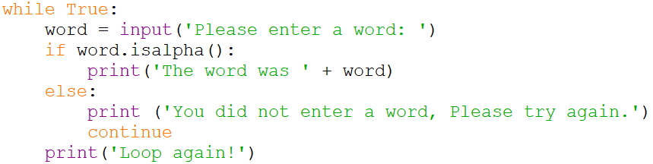
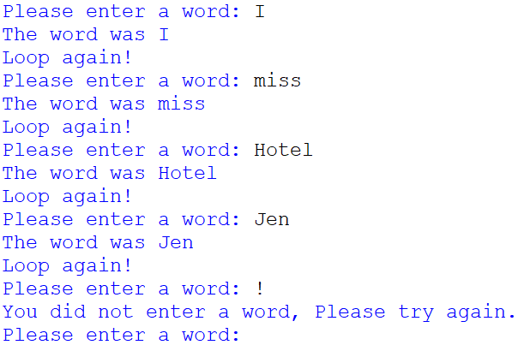
continue Statement - Example
Notes:
Example of the continue statement.
Notice when the input was exclamation. The statement print loop again was skipped and the next iteration of the loop began.

Slide 25
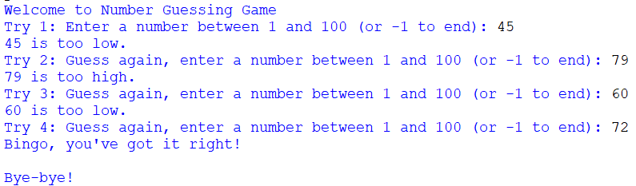
Activity 4 – NumberGuessing.py
Write a program that simulates a number guessing game. It first generates a random number between 1 and 100. It then prompts user to guess the correct number. User can enter -1 to end the game or the game will end after 5 tries.
Sample outputs of the program:

Slide 26
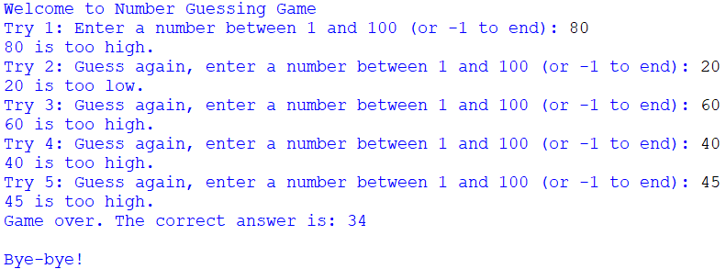
Activity 4 – NumberGuessing.py

Slide 27
Reading Reference
Python 3 Documentation
https://docs.python.org/3/reference/compound_stmts.html#while
Learn Python Tutorial
https://www.learnpython.org/en/Loops

Slide 28
Summary
Repetition structure allows statements to be repeated until certain condition failed
The while loop checks the condition first to decide whether to enter the loop
The break statement breaks out of the loop completely.
The continue statement skips the remaining part of the current iteration and continues to the next iteration.

